Slide 1
Voice controlled Light System
Sravanthi Kapu

Slide 2
Home Automation Systems is used to make a luxury and sophisticated home automation platforms. It makes it easy for the elderly and the disabled to control appliances in Home.
The aim of the idea Controlling light system with voice recognition is to provide those with special needs with a system that can respond to voice commands and control the on/off status of electrical devices, such as lamps, fans, television etc, in the home .

Slide 3
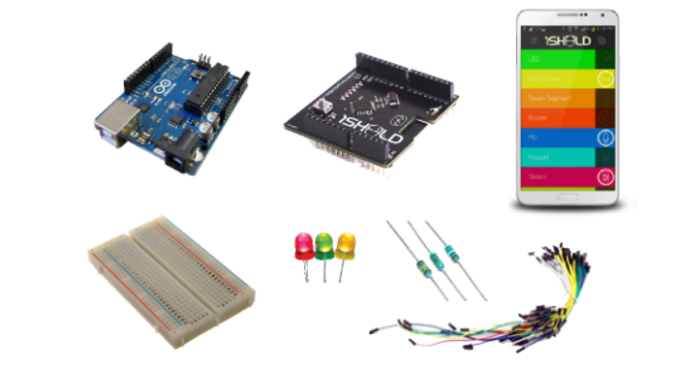
Hardware used:
Arduino UNO R3
1Sheeld
1Sheeld app
Jumper wires
LED’S
Resistors
Push button
Bread board

Slide 4
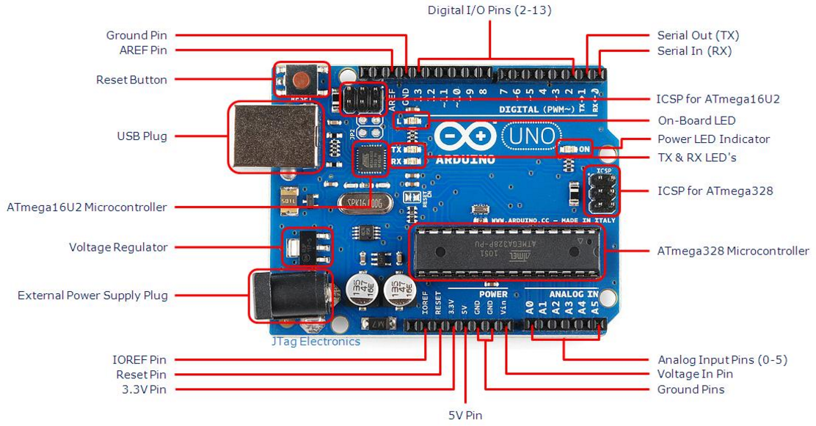
Arduino
Arduino/Genuino Uno is a microcontroller board based on the ATmega328P. It has 14 digital input/output pins (of which 6 can be used as PWM outputs), 6 analog inputs, a 16 MHz quartz crystal, a USB connection, a power jack, an ICSP header and a reset button. It contains everything needed to support the microcontroller;

Slide 5
1Sheeld:
1Sheeld is a new easily configured shield for Arduino. It is connected to a mobile app that allow the usage of all of Android smartphones' capabilities such as LCD Screen, Gyroscope, Switches, LEDs, Accelerometer, Magnetometer, GSM, Wi-Fi, GPS &hellip ; etc. into your Arduino sketch.
1sheeld consists of two parts. The first part is a shield that is physically connected to your Arduino board and acts as a wireless middle-man, piping data between Arduino and any Android smartphone via Bluetooth. The second part is a software platform and app on Android smartphones that manages the communication between our shield and your smartphone and let your choose between different available shields.
variety of shields are developed for 1Sheeld like LED, Toggle Button, Buzzer, Slider, LCD, 7-Segment, Keypad, Music Player, Game Pad, Notifications, Twitter, Facebook, Foursquare, Gyroscope, SMS, Flashlight and Mic which uses the sensor in the mobile.

Slide 6
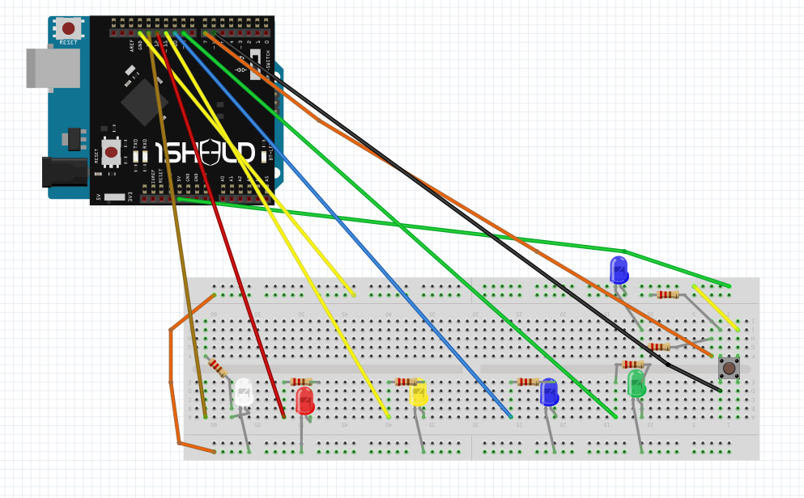
Circuit:

Slide 7
Sensors used
Once 1Sheeld is connected, connect the below sensors / shields: SMS, text to speech , voice recognition , light.
SMS Shield - Allows you to send an SMS to a phone number when a certain trigger is on.
Voice Recognition Shield- Control your Arduino with voice commands with 1 line of code, you can trigger it to control a robot or talk to your home appliances!
Light sensor shield - This shield is one of the sensor shields. Sensor shields allows you to tap into your smartphone’s sensors and use in prototyping with Arduino, you can get information from the surrounding environment and use it to trigger a certain action.
Text to speech shield -Let your Arduino board talk to you, get text from Arduino and convert into speech to hear through the smart phone’s speaker. This shield is one of the special shields, it allows Arduino board to use some capabilities your smartphone can do, like playing music, taking a picture, getting notifications, accessing the clock data and using the touch screen for various functions.

Slide 8
Controlling lights with voice recognition
In order to control the lights by our voice, we first need to enable the voice recognition sensor in 1shield Application in our mobile. Then tap on the speaker and by speaking which ever colour light we want or its specific name then that particular light gets on. In this project, there are 5 lights: red, blue, green, yellow and cream. There is also one more option “dance” so when this command is used, the light on and off in specific time interval until next command is given.
The list of commands and their operations:
Voice commands | Operation
red | turns on red light
blue | turns on blue light
green | turns on green light
cream | turns on cream light
yellow | turns on yellow light
dance | Turns on all lights and turns off all lights one after the other till a new command is received.
play | turns on all lights
stop | turns off all lights

Slide 9
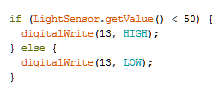
Controlling Lights depending on the Light intensity in the room:
The light sensor in the 1shield app should be on. Then the sensor detects the light intensity and depending on it if the room is dark, the lights get on automatically and when it’s bright then the lights turn off automatically.
Code snippet:

Slide 10
Controlling lights with SMS and getting notifications:
We can also control the lights by sending the SMS to the mobile which is connected to the 1shield.
Whenever the status of the lights are changed we get an SMS notification to the mobile through the lights are controlled.
sms commands | Operation
red | turns on red light
blue | turns on blue light
green | turns on green light
cream | turns on cream light
yellow | turns on yellow light
dance | Turns on all lights and turns off all lights one after the other till a new command is received.
play | turns on all lights
stop | turns off all lights
GetMeAccess007 | the person who sent the sms gets access to control light system
removeme | the user will lose the access to control lights
changeadmin | To get the admin access, need to send this command / password and then need to press the push button in specific time.

Slide 11
USER ACCESS:
By sending the password as message to the sensor, the user can get access to the system to control the lights.
If the user doesn’t want access, just by sending another password, he can get out of the users list. So he can’t access the light system anymore.

Slide 12
ADMIN:
Whoever the user is, there will be one admin. We can change the admin but can never remove the admin. So in order for a client to become admin, he first needs to send a password. Then within 10 sec he needs to press the switch in the connection to get access. This system is implemented to make sure the person is having access to the home and not just a stranger gets access just by sending the password.

Slide 13
Ideas to implement for security:
How can you protect this light from being accessed or controlled by non- authorized users?
We will set the authorized users list (for example the family members in the house). When a user sends password to get access, the algorithm first checks if the user is one of the authorized user or not. If he is a member of the list, just by sending password he gets the access. If he is not the one in the list, admin receives a message with the details of user who sent the password, if the admin replies OK, the user gets access. If the admin doesn’t reply the access for the unauthorized user is denied.

Slide 14
CONCLUSION:
Developed a system in which the below implementations are done:
1. Connected Ardiuno and1sheeld and able to use the sensors in1sheeld app.
2. Able to control lights using voice recognition.
3. Implemented the delivery of Message to mobile whenever the lights are accessed.
4. Implemented the voice notification through the 1sheeld app whenever the lights are accessed.
5. Can access the lights through a message.
6. Using the light sensor through the 1sheeld app and to make sure lights turn on automatically if the light intensity in the room is below a specific level.
7. To get access to another mobile number by sending the password, so if our mobile is switched off, still we can control the lights through another mobile.
8. Keeping an admin who has control to the system always, whereas another user can get the access by sending the password.
Web Page link : http://www.cs.odu.edu/~skapu/project%20page/lightsystem.html

Slide 15

Any Questions ????

Slide 16


